Slide 1
Solar Access Case Study
Objective:
To evaluate sales performance, product dynamics, and repayment behavior across Area A and Area B.
github repository

Slide 2
Exploratory Data Analysis

Slide 3
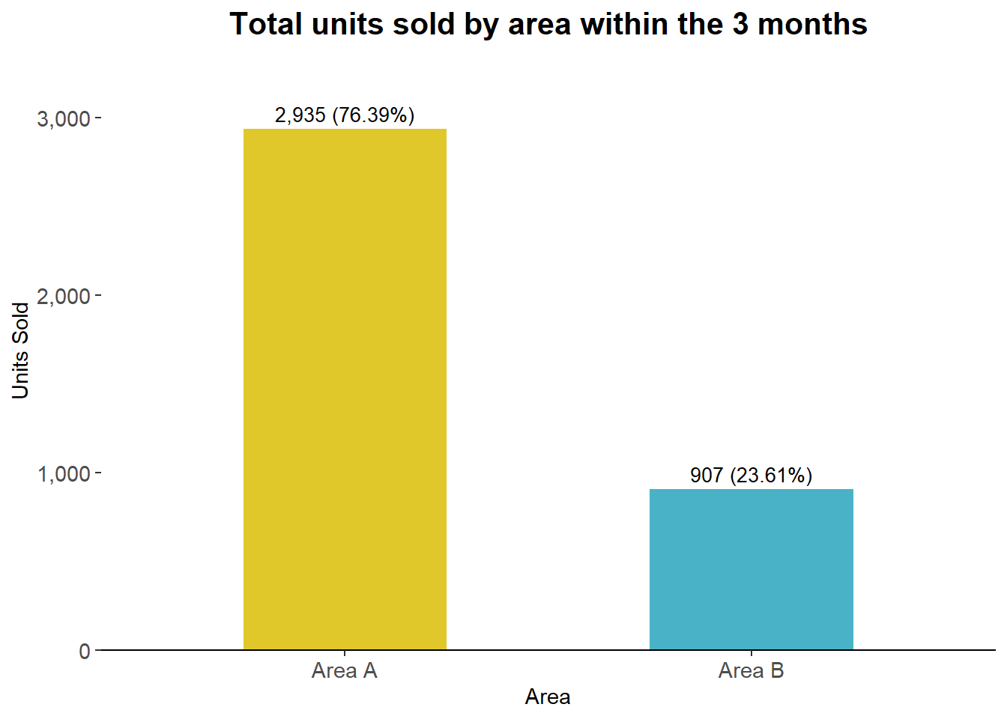
Total Sales Comparison: Area A vs Area B (3-Month Period)
Between December 2023 and February 2024, a total of 3,842 units were sold across both areas. Area A accounted for the majority of sales, with 2,935 units (76.39%), while Area B recorded 907 units (23.61%). Based on these results, Sunking should prioritize targeted growth initiatives in Area B while sustaining performance in Area A. Focus on diagnosing the drivers of lower sales in Area B, such as distribution gaps, pricing, or demand differences, and pilot interventions (e.g, promotions, channel expansion, or localized marketing) to close the performance gap.

Slide 4
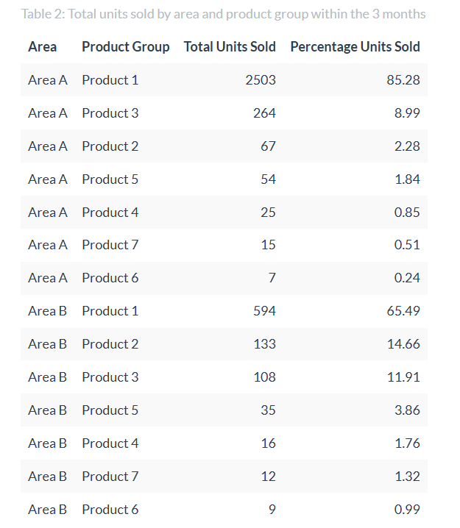
Product Group Performance Comparison Across Areas
Between December 2023 and February 2024, a total of 3,842 units were sold across both areas. Area A accounted for the majority of sales, with 2,934 units (76.36%), while Area B recorded 908 units (23.64%). Product 1 is the most accessed in both areas( 85.28% in Area 1, and 65.49% in Area 2), while Product 3 performs second best in Area 1 (8.99%), while product 2 performs best in Area 2 (14.66%). Sunking should scale Product 1 and 3 from Area A into Area B, to improve overall uptake.

Slide 5
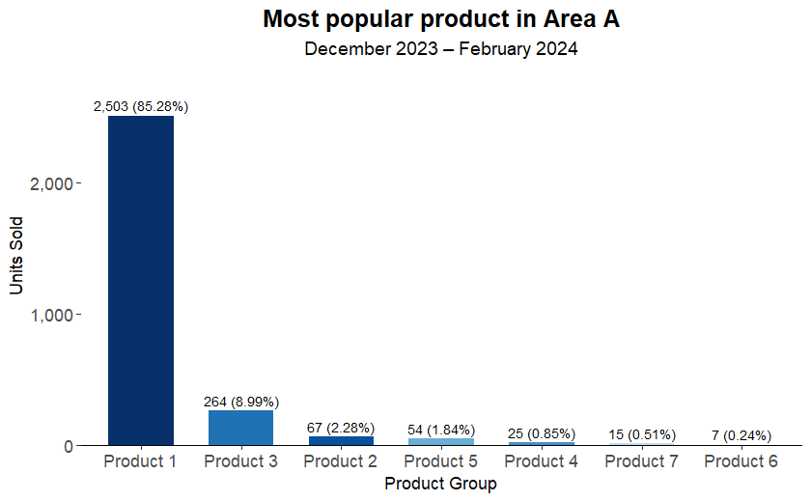
Top-Selling Product in Area A and Its Share of Total Sales
Product 1 is the most popular product in Area A, with 2,503 units sold, representing 85.28% of all Area A sales, with the remaining six product groups collectively accounting for only 14.72% of sales.

Slide 6
Sample Size Calculation
Assumptions:
Current 14-day repayment rate in the control group: 40%
Minimum improvement worth detecting: 5 percentage points
So treatment repayment rate would be 45%
Significance level (alpha): 5%
Statistical power: 80%
Equal allocation between treatment and control: 50:50
Assume a simple randomized experiment at customer level

Slide 7
Power Calculation to Determine Sample Size
I used the https://www.powercalc.ca/ statistical software to compute the sample size using the assumptions provided.
A total sample of 3,068 customers is required, with at least 1,534
in the experimental group and 1,534 in the control group. This is sufficient to detect a 5 percentage point improvement in the 7-day repayment rate, from 40% in the control group to 45% in the experimental group, assuming 80% statistical power and a two-sided significance level of 0.05.
If the minimum detectable effect were smaller, the required sample size would increase substantially, as smaller differences demand greater precision to distinguish a true effect from random variation.

Slide 8
Collection Performance Metrics

Slide 9
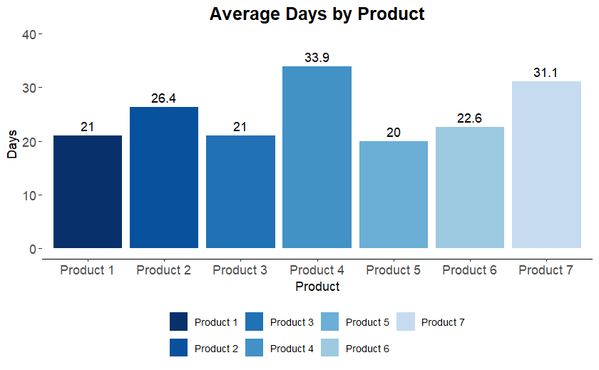
Product Performance Analysis
Product performance varies meaningfully, with Product 4 and Product 7 showing the longest durations at 33.9 and 31.1 days respectively. In contrast, most other products cluster in the 20-day range, with Product 5 being the shortest at 20 days. Sunking’s operation’s team should Investigate drivers of longer durations for Product 4 and Product 7 while optimizing faster-moving products. The significant gap suggests that Product 4 and 7 may face operational or demand-related challenges. Consider reviewing supply chain, production, or marketing factors to reduce duration, and apply best practices from faster-selling products like Product 5 to improve overall efficiency.

Slide 10
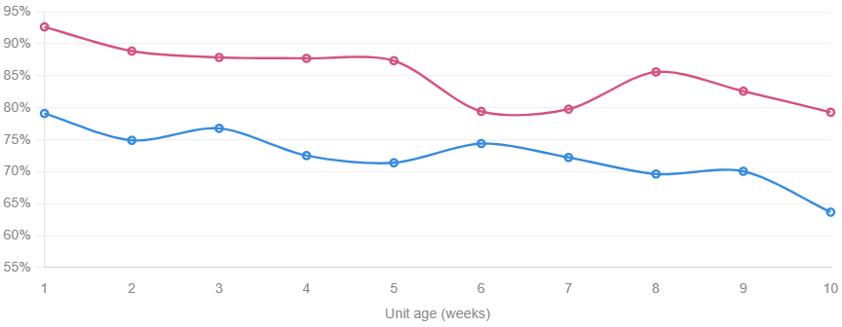
Repayment speed: Product 1, Area A, July 18 2024 (first-half registrations), vs Repayment speed by unit age week, Area A vs Area B (weeks 1–10) Area A
Total collected 21,296 | Total expected 37,740 | Repayment Speed 56.4%
Area B consistently outperforms Area A on repayment speed across all unit age weeks. Area B starts near 93% in week 1 and declines to ~79% by week 10. Area A starts at 79% and declines to 64% by week 10. Both areas show a declining trajectory as accounts age, which is typical in PAYG portfolios.
Sunking should leverage best practices from Area B to improve Area A repayment speed. Investigate operational, customer engagement, or credit management strategies driving higher early repayments in Area B and implement targeted interventions in Area A to improve portfolio performance.

Slide 11
Experiment conclusions
Both areas show a declining repayment speed trend across the weeks. Area B remains higher throughout, but this may reflect pre-existing differences rather than the experiment. The absence of a clear improvement in Area A specifically warrants further investigations on factors leading to the trend.
Because accounts registered in Dec 2023–Feb 2024 are all aging together, it is difficult to isolate the experiment effect from the natural aging curve. A proper difference-in-differences analysis comparing pre/post registration cohorts in treated vs control areas would be needed for a valid causal conclusion. The data does not cleanly separate treatment from control within the same area, so no strong conclusion about causality can be drawn from this analysis alone.

Slide 12
A/B Test Design for PAYG Payment Compliance
A detailed A/B test design can be found in this report

